Slide 1
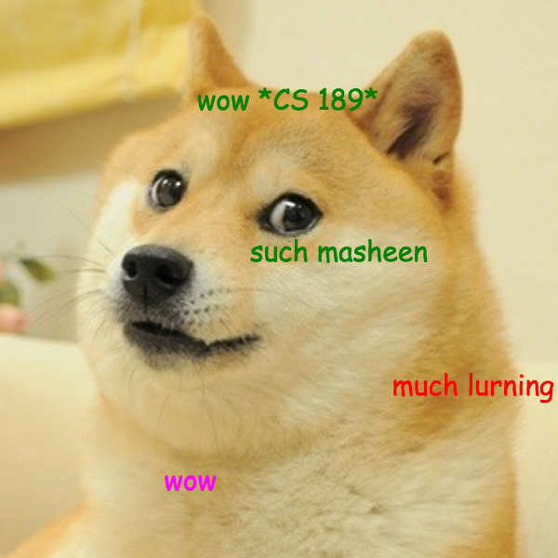
CS 189
Brian Chu
brian.c@berkeley.edu
Slides at: brianchu.com/ml/
Office Hours:
Cory 246, 6-7p Mon. (hackerspace lounge)
twitter: @brrrianchu

Slide 2
Agenda
Random forests
Bias vs. variance revisited
Worksheet

Slide 3
HW Tip
Random forests are “embarrassingly parallel”
Python multiprocessing
Spam class 0 frequency: 0.71

Slide 4
Random forests
Why do we use bootstrap?
De-correlate trees (reduce variance)
"Sampling with replacement behaves on the original sample the way the original sample behaves on a population”

Slide 5
Bias vs. variance revisited
Decision trees with long depth are very prone to overfit → low bias, high variance
Decision “stump” with a max depth of 2 does not overfit, not complex enough → high bias, low variance

Slide 6
Bias vs. variance revisited
Random forest: take a bunch of low bias, high variance trees, try to lower the variance
  Bias is already low, don’t worry about it, attack variance
  (by parallel training with randomization, then taking majority vote)
  randomization attacks the variance
Boosting: train a bunch of high bias, low variance learners, try to lower the bias
  Variance is already low, don’t worry about it, attack bias
  (by sequential training with re-weighting, then finding weighted average classification)
  re-weighting attacks the bias
boosting can be used with any learner, ideally a weak learner (common variant: linear SVMs)

Slide 7
Random forests and boosting
Both are “ensemble” methods
Both are among the most widely used ML algorithms in industry (the standard for fraud/spam detection)
  neural nets not used for fraud/spam type tasks.
In practice: random forests work better out-of-the-box (less tuning). But with tuning, boosting usually performs better.
Most classification Kaggle competitions won by: 1) boosting, or 2) neural nets

Slide 8
Cool places RF/Boosting is used
https://www.quora.com/What-are-the-most-effective-boosting-methods/answer/Tao-Xu (boosting)
http://research.microsoft.com/pubs/145347/BodyPartRecognition.pdf (kinect, RF)
http://nerds.airbnb.com/unboxing-the-random-forest-classifier/ (RF)
http://www.herbrich.me/papers/adclicksfacebook.pdf (boosting + logistic reg.)
Twitter, etc.

Slide 9
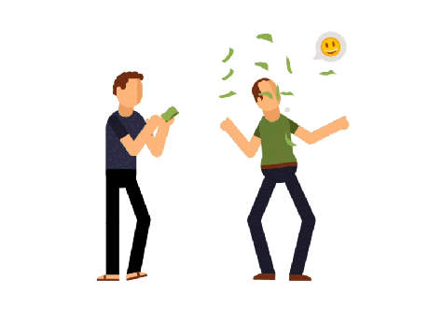
Next time: NEURAL NETWORKS

